Slide 1
Design in Software Construction

Slide 2
Contents
Introduction
Design Challenges
Key Design Concepts
Design Building Blocks: Heuristics
Design Practices
Key Points

Slide 3
Introduction
Some people might argue that design isn’t really a construction activity, but on small projects, many activities are thought of as construction, often including design.
Even in some larger projects, a formal architecture might address only the system-level issues and much design work might intentionally be left for construction.

Slide 4
Introduction
“Design” might be
just writing a class interface in pseudo code before writing the details.
Drawing diagrams of a few class relationships before coding them.
Asking another programmer which design pattern seems like a better choice.
Regardless of how it’s done, small projects benefit from careful design just as larger projects do.
Recognizing design as an explicit activity maximizes the benefit you will receive from it.

Slide 5
Design Challenges
The phrase “software design” means the conception and invention of a scheme for turning a specification for computer software into operational software.
Design is the activity that links requirements to coding and debugging.
Good design is useful for small projects and essential for larger projects.

Slide 6
Design Challenges
Design is marked by numerous challenges, which are (details from book Pg. 74-76)
Design is a wicked problem
Design is a sloppy process
Design is about tradeoffs and priorities
Design Involves Restrictions
Design Is Nondeterministic
Design Is a Heuristic Process
Design Is Emergent

Slide 7
Key Design Concepts
Good design depends on understanding a handful of key concepts.
Some of these key concepts are
Role of complexity
Desirable characteristics of designs
Levels of design

Slide 8
Managing Complexity
When software-project surveys describe the causes of project failure, they rarely identify technical reasons as the primary causes of project failure.
Projects fail most often because of poor requirements, poor planning, or poor management.
But when projects do fail for reasons that are primarily technical, the reason is often uncontrolled complexity.
The software is allowed to grow so complex that no one really knows what it does.
When a project reaches the point at which no one completely understands the impact that code changes in one area will have on other areas, progress grinds to a halt.

Slide 9
Managing Complexity
Managing complexity is the most important technical topic in software development.
Dijkstra (Computing Pioneer) pointed out that no one’s skull is really big enough to contain a modern computer program, which means that we as software developers shouldn’t try to cram whole programs into our skulls at once.
We should try to organize our programs in such a way that we can safely focus on one part of it at a time.
The goal is to minimize the amount of a program you have to think about at any one time.

Slide 10
Managing Complexity
At the software-architecture level, the complexity of a problem is reduced by dividing the system into subsystems.
The goal of all software-design techniques is to break a complicated problem into simple pieces.
The more independent the subsystems are, the more you make it safe to focus on one bit of complexity at a time.

Slide 11
Managing Complexity
Overly costly, ineffective designs arise from three sources:
A complex solution to a simple problem
A simple, incorrect solution to a complex problem
An inappropriate, complex solution to a complex problem

Slide 12
Managing Complexity (How to Attack Complexity)
As Dijkstra pointed out, modern software is inherently complex, and no matter how hard you try, you’ll eventually bump into some level of complexity that’s inherent in the real-world problem itself.
This suggests a two-prong approach to managing complexity:
Minimize the amount of essential complexity that anyone’s brain has to deal with at any one time.
Keep accidental complexity from needlessly proliferating.
Once it is understood that all other technical goals in software are secondary to managing complexity, many design considerations become straightforward.

Slide 13
Desirable Characteristics of a Design
A high-quality design has several general characteristics.
If you could achieve all these goals, your design would be very good indeed.
Some goals contradict other goals, but that’s the challenge of design—creating a good set of tradeoffs from competing objectives.

Slide 14
Desirable Characteristics of a Design
Here’s a list of required design characteristics (details from book Pg. 80, 81)
Minimal Complexity
Ease of Maintenance
Loose Coupling
Extensibility
Reusability
High Fan-in
Low to medium fan-out
Portability
Leanness
Stratification
Standard Techniques

Slide 15
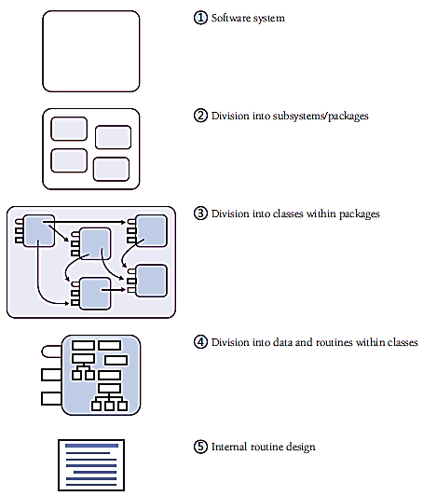
Levels of Design
Design is
needed at
several
different levels
of detail in a
software
system.

Slide 16
Levels of Design Level 1: Software System
The first level is the entire system.
Some programmers jump right from the system level into designing classes, but it’s usually beneficial to think through higher level combinations of classes, such as subsystems or packages.

Slide 17
Levels of Design Level 2: Division into Sub Systems/Packages
The main product of design at this level is the identification of all major subsystems.
The major design activity at this level is deciding how to partition the program into major subsystems and defining how each subsystem is allowed to use each other subsystem.
Division at this level is typically needed on any project that takes longer than a few weeks.
Within each subsystem, different methods of design might be used—choosing the approach that best fits each part of the system.

Slide 18
Levels of Design Level 2: Division into Sub Systems/Packages
Of particular importance at this level are the rules about how the various subsystems can communicate.
If all subsystems can communicate with all other subsystems, you lose the benefit of separating them at all.
Make each subsystem meaningful by restricting communications.

Slide 19
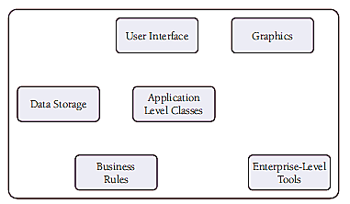
Levels of Design Level 2: Division into Sub Systems/Packages
Consider the following example. A system is divided into six sub systems

Slide 20
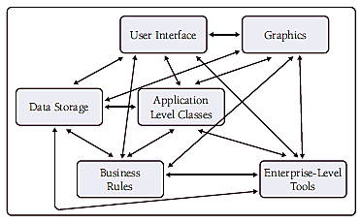
Levels of Design Level 2: Division into Sub Systems/Packages
This will happen when there is no restriction on inter subsystems communication

Slide 21
Levels of Design Level 2: Division into Sub Systems/Packages
Every subsystem ends up communicating directly with every other subsystem, which raises some important questions:
How many different parts of the system does a developer need to understand at least a little bit to change something in the graphics subsystem?
What happens when you try to use the business rules in another system?
What happens when you want to put a new user interface on the system, perhaps a command-line UI for test purposes?
What happens when you want to put data storage on a remote machine?

Slide 22
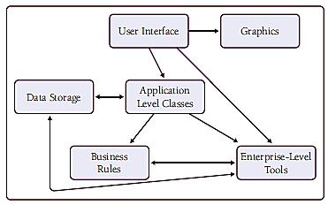
Levels of Design Level 2: Division into Sub Systems/Packages
All of these issues can be addressed with little extra work.
Allow communication between subsystems only on a “need to know” basis.

Slide 23
Levels of Design Level 2: Division into Sub Systems/Packages
To keep the connections easy to understand and maintain, consider the following inter subsystem relations.
The simplest relationship is to have one subsystem call routines in another.
A more involved relationship is to have one subsystem contain classes from another.
The most involved relationship is to have classes in one subsystem inherit from classes in another.
A good general rule is that a system-level diagram should be an acyclic graph. In other words, a program shouldn’t contain any circular relationships in which Class A uses Class B, Class B uses Class C, and Class C uses Class A.

Slide 24
Levels of Design Level 3: Division into Classes
Design at this level includes identifying all classes in the system.
Details of the ways in which each class interacts with the rest of the system are also specified as the classes are specified.
In particular, the class’s interface is defined.
Overall, the major design activity at this level is making sure that all the subsystems have been decomposed to a level of detail fine enough that you can implement their parts as individual classes.

Slide 25
Levels of Design Level 4: Division into Routines
Design at this level includes dividing each class into routines.
The class interface defined at Level 3 will define some of the routines.
Design at Level 4 will detail the class’s private routines.
When you examine the details of the routines inside a class, you can see that many routines are simple boxes.

Slide 26
Levels of Design Level 4: Division into Routines
The act of fully defining the class’s routines often results in a better understanding of the class’s interface, and that causes corresponding changes to the interface—that is, changes back at Level 3.
This level of decomposition and design is often left up to the individual programmer, and it’s needed on any project that takes more than a few hours.
It doesn’t need to be done formally, but it at least needs to be done mentally.

Slide 27
Levels of Design Level 5: Internal routine Design
Design at the routine level consists of laying out the detailed functionality of the individual routines.
Internal routine design is typically left to the individual programmer working on an individual routine.
The design consists of activities such as writing pseudo code, looking up algorithms in reference books, deciding how to organize the paragraphs of code in a routine, and writing programming-language code.

